Slide 1



Alyona Galyeva
Bootcamp
Bringing ML Models
into Production
Lesson 2: Batch

Slide 2
Agenda
Recap
Deployment setup
Batch inference on Azure
Exercises & Home assignment

Slide 3
Recap

Slide 4
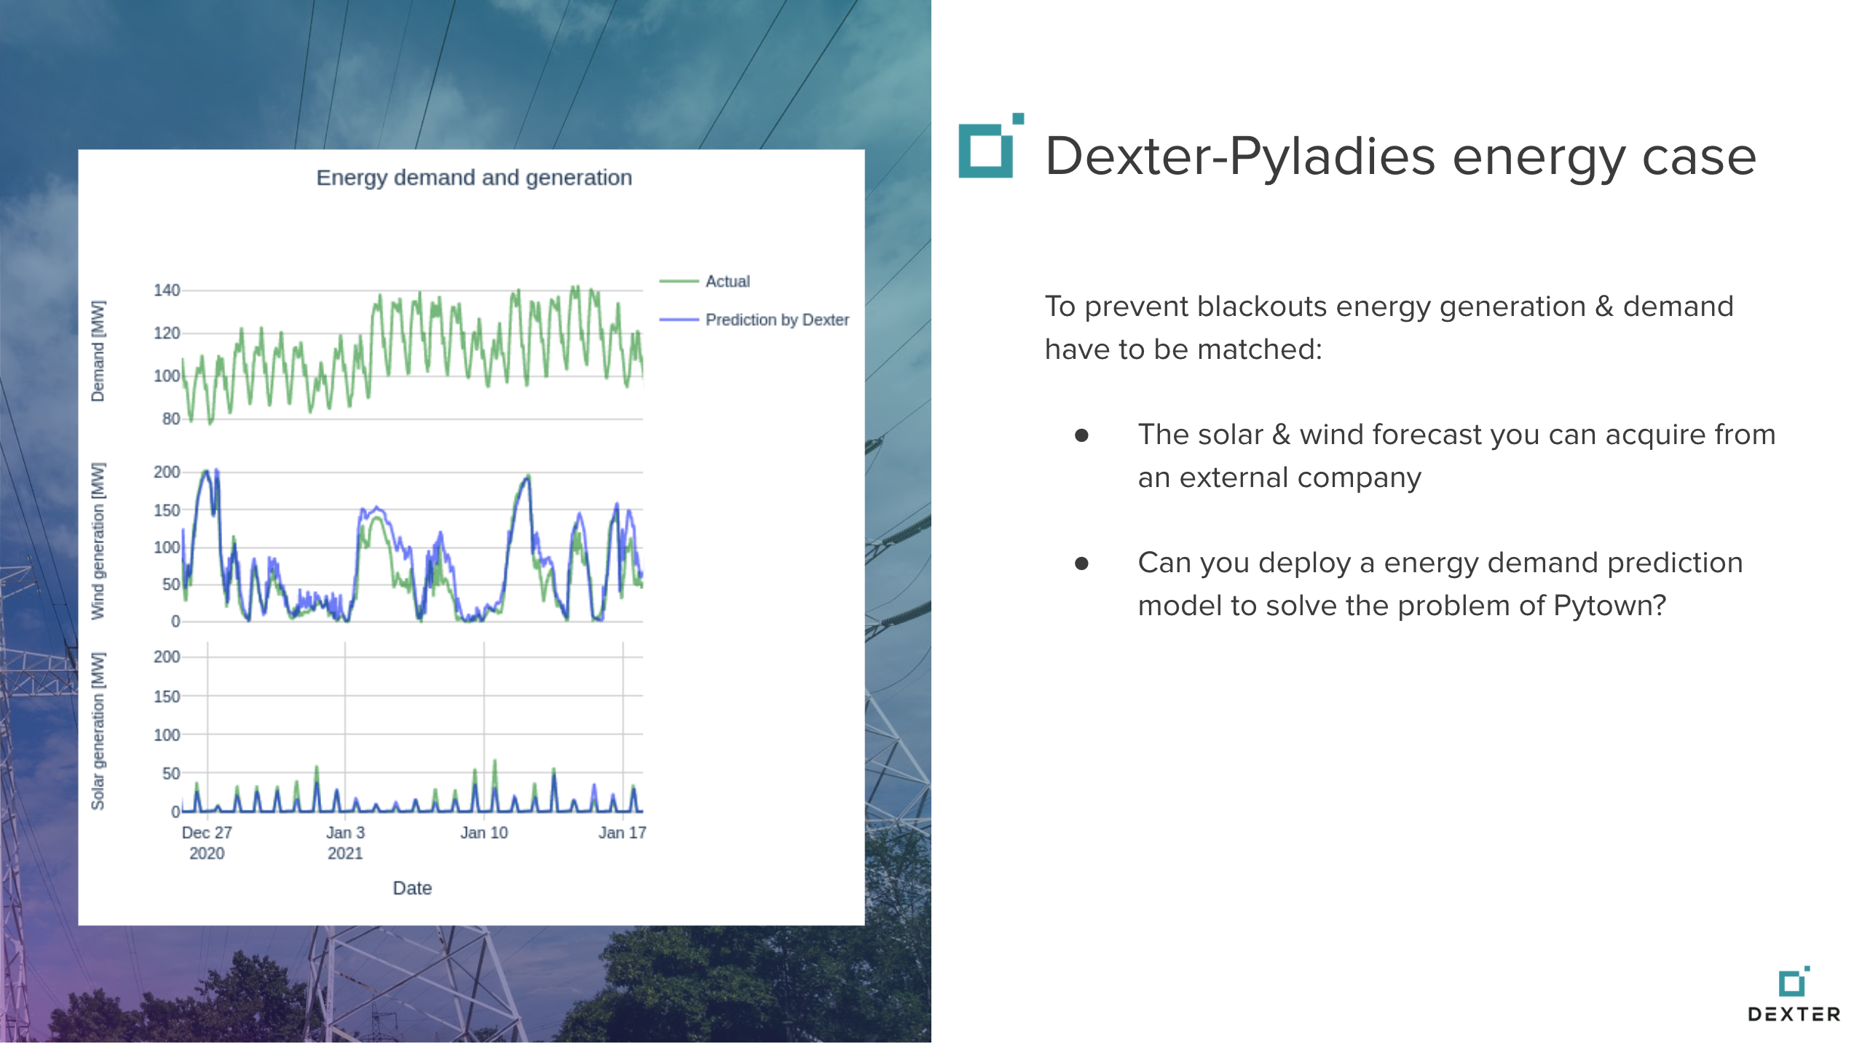

Slide 5
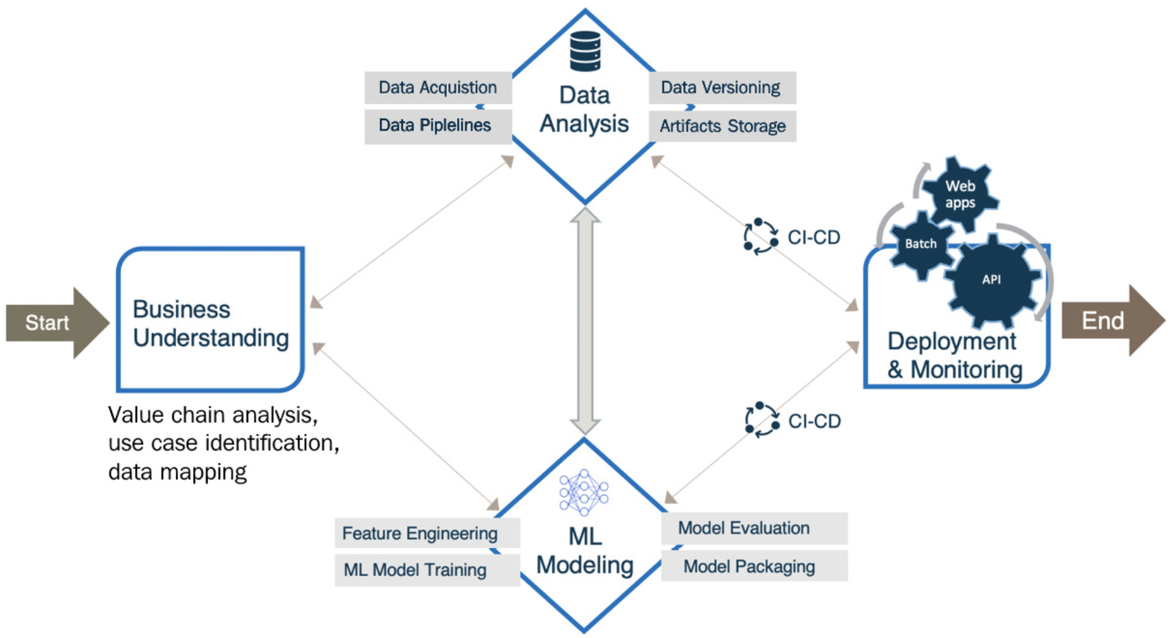
Source: Emmanuel Raj. Engineering MLOps. Chapter 2. Figure 2.1 – ML solution development process

Slide 6
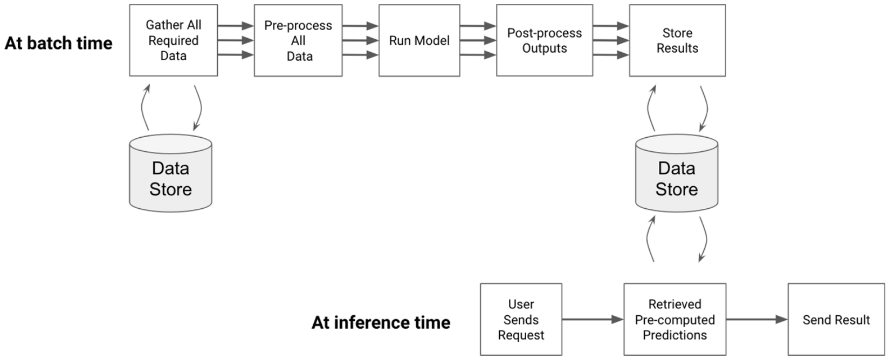
Batch Workflow
Source: Emmanuel Ameisen. Building Machine Learning Powered Applications. Chapter 9. Figure 9-3. Example of batch workflow

Slide 7
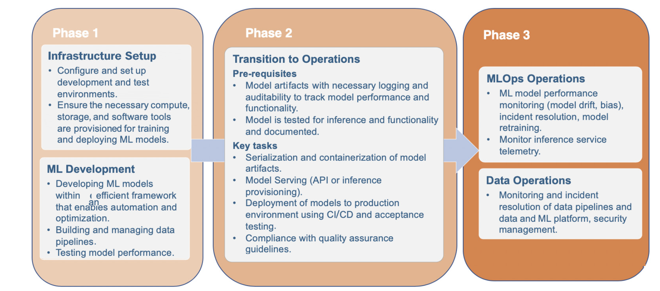


Source: Emmanuel Raj. Engineering MLOps. Chapter 2. Figure 2.10 – Implementation roadmap for an MLOps-based solution

Slide 8

Deployment setup

Slide 9
Tips
Set up some costs alerts -> email
Never hardcode secrets in your code
For local dev – use .env (add it to gitignore)
For cloud dev such as Azure use Azure Key Vault

Slide 10
Steps
Prerequisites
Data preparations (EDA, Dataset registration)
Model training (Train models locally with logging experiments to the cloud by using train set for validation as well)
Model evaluation and registration (exercise register another model)

Slide 11

Batch inference on Azure

Slide 12
Steps
Scoring script
conda.yml for inference
Setup AML compute (Attach cluster, start cluster, stop cluster // python or az // )
Setup Azure Machine Learning Pipeline (Set up azure pipeline to run inference in python or yaml ??? Schedule pipeline python or yaml??? (schedule for another time) )
Home assignment – register and deploy as batch inference another model from the list – follow all deployment setup steps starting from train model locally

Slide 13

Exercises & Home assignment

Slide 14
Exercises & Home assignment – Lesson 2
https://github.com/pyladiesams/bootcamp-bringing-ML-models-into-production-intermediary-jun-aug2021/blob/master/bootcamp/lesson2/lesson2_tasks.md

Slide 15
print(f“{user_name} thanks for watching”)

